Slide 1

How to Use a
Computer
Introduction
Lesson 1

Slide 2

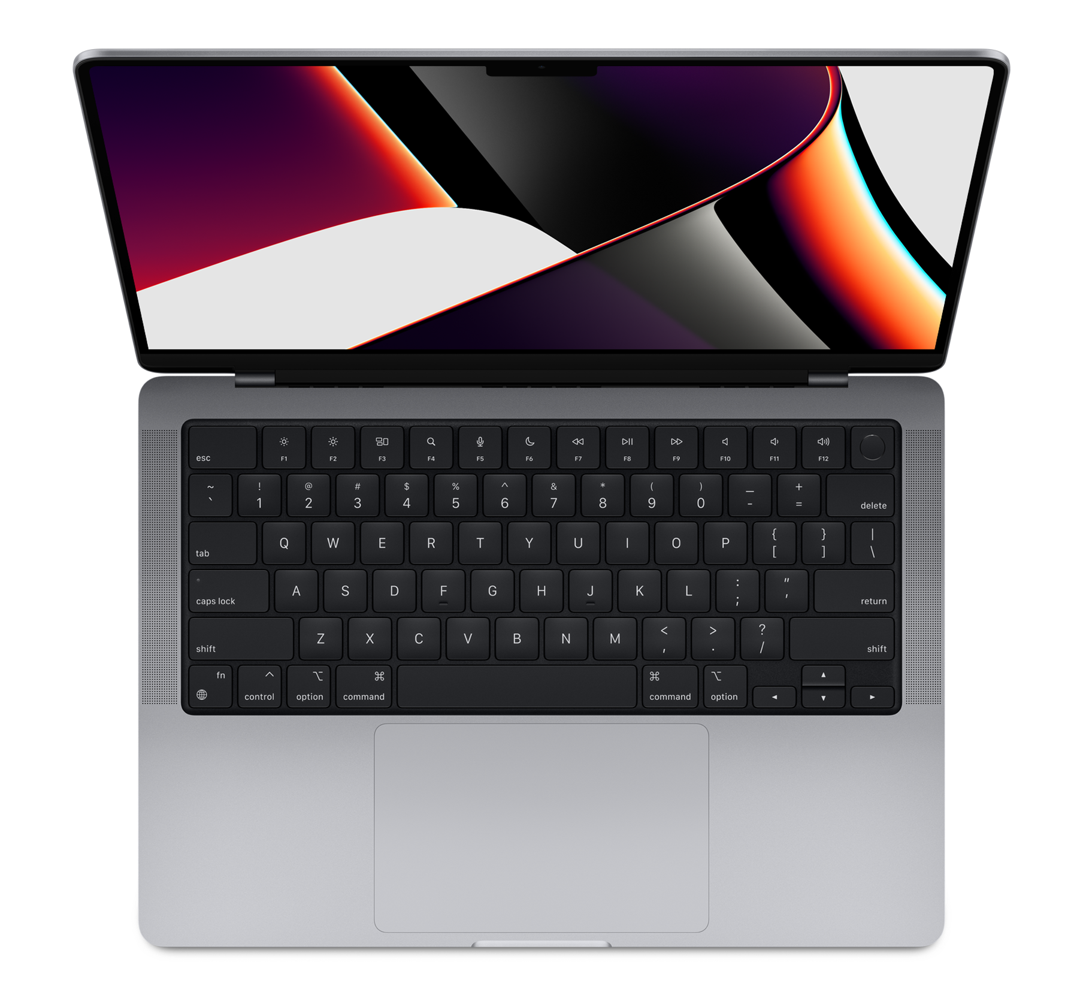

Turning the
Computer On: Laptop
Regardless of the type of computer, the power button is usually located on the top right corner of the keyboard
To turn the computer on, just press the power button
To restart the computer, press and hold down the power button

Slide 3
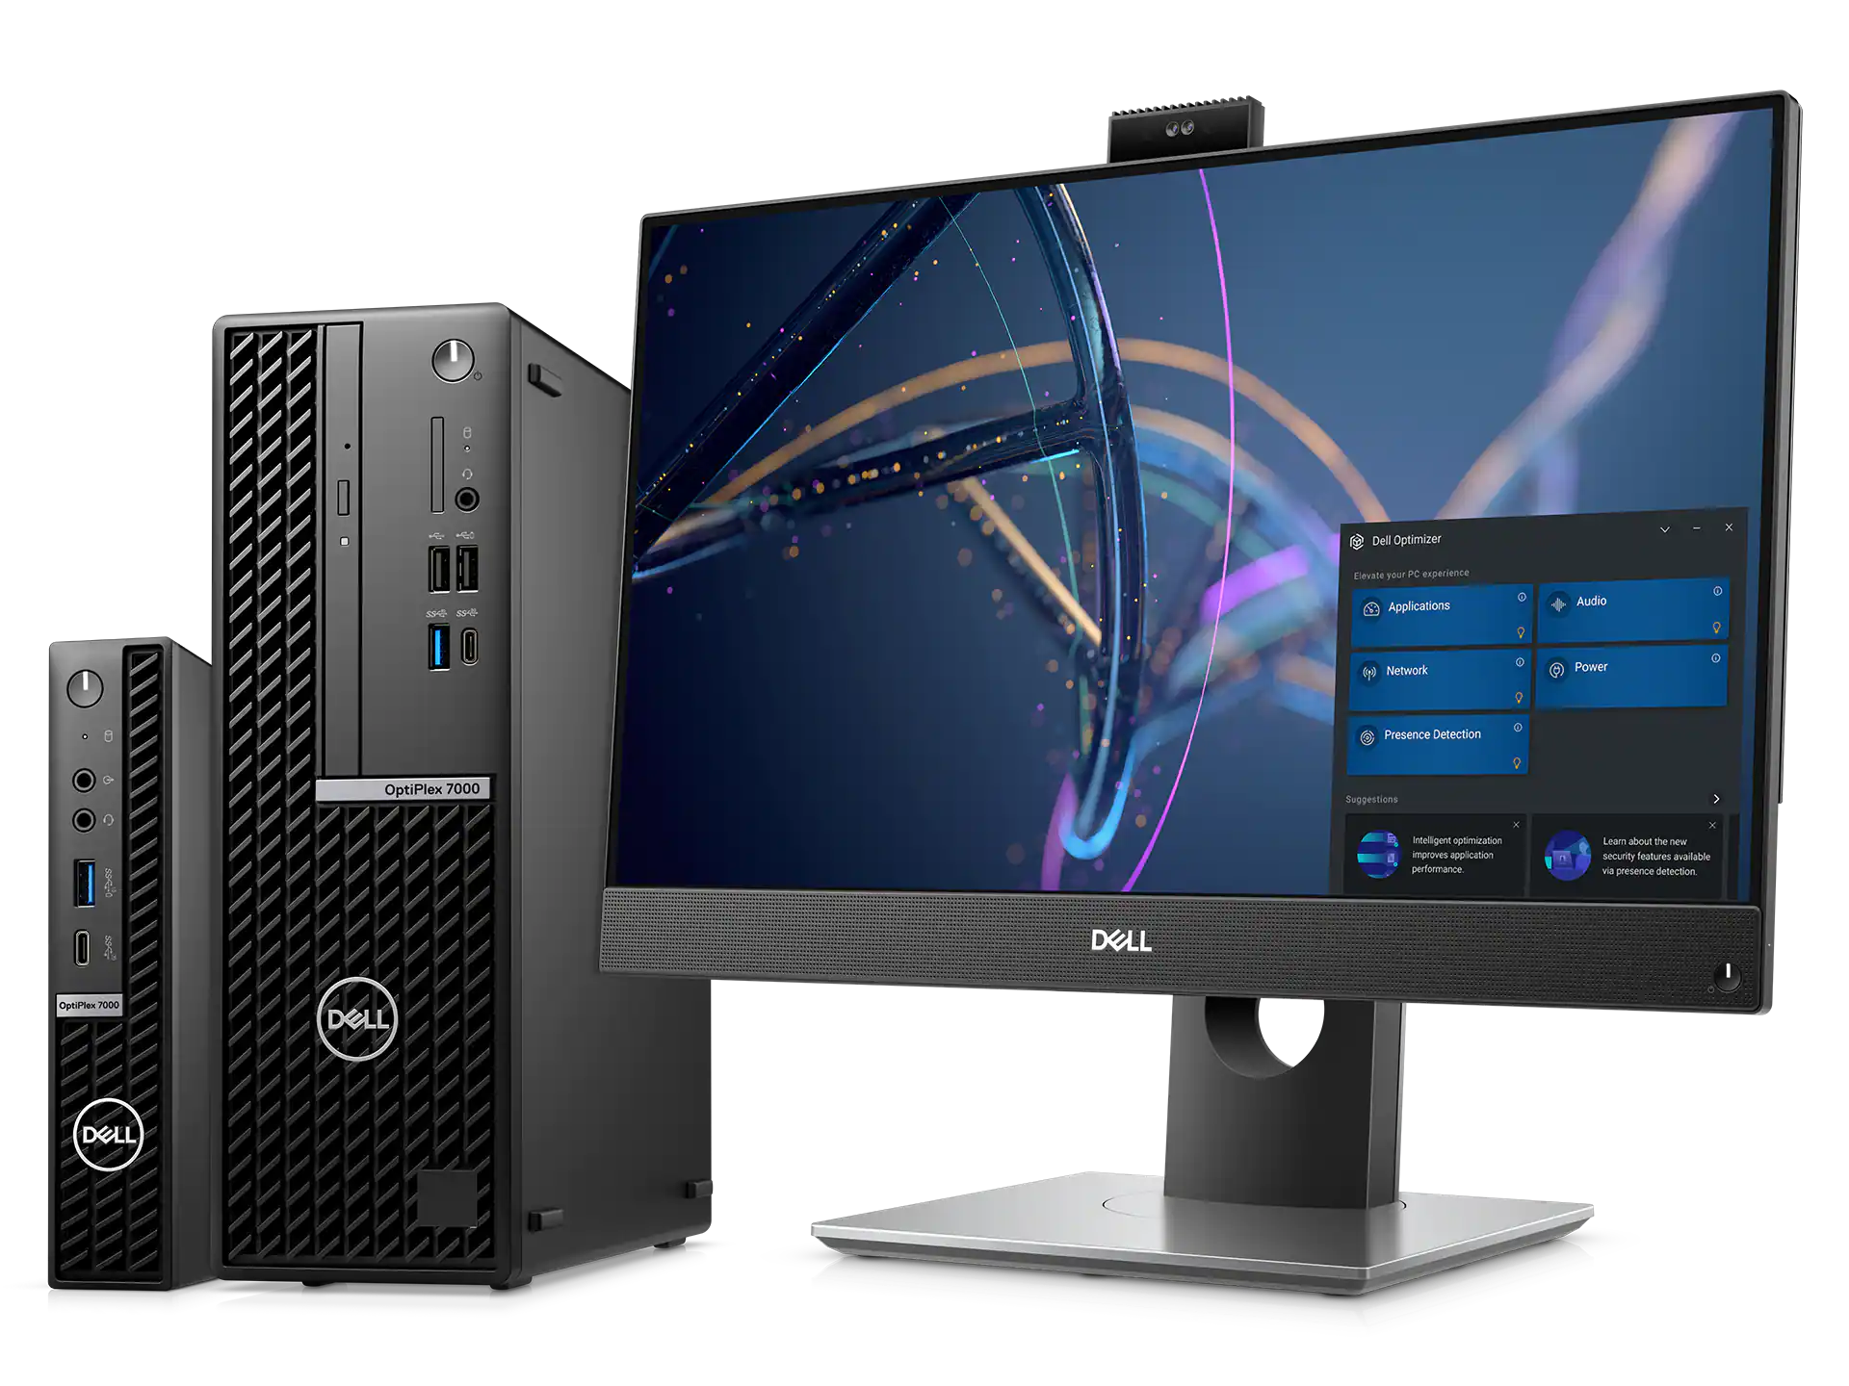
Turning the
Computer On: Desktop
If you are using a desktop, look for the power button on the computer itself
To turn the computer on, just press the power button
To restart the computer, press and hold down the power button

Slide 4

Once the computer has turned on, you may need to login
This means typing in your username and password
If you have never used this computer, you may need to create an account
Login to Your Computer

Slide 5
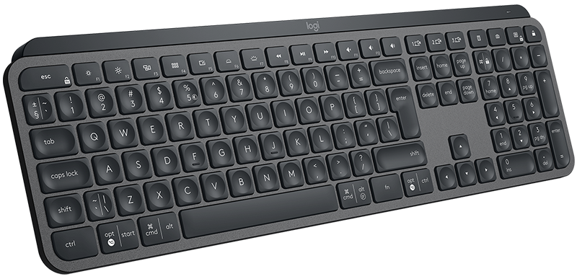
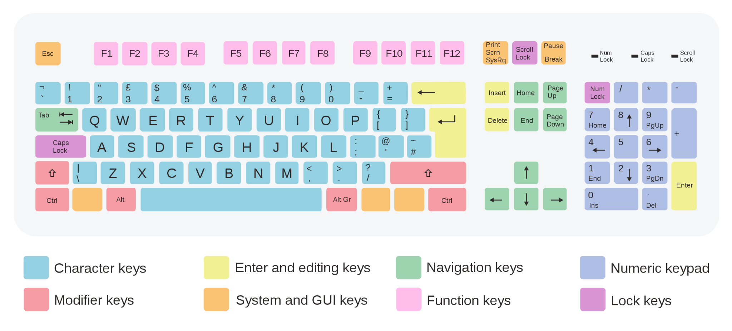
Keyboard
The keyboard is the panel in front of a computer screen
It is used to put information, including words, numbers, and symbols, onto the computer screen
Each individual button is called a key

Slide 6
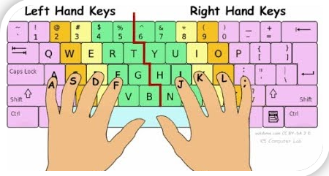
Learning to Type
Learning to type fast and accurately takes time but is a very useful skill
Use your left hand to type on the left side of the keyboard and your right hand to type on the right half of the keyboard
Try the link below to practice
Typing Practice Drills

Slide 7
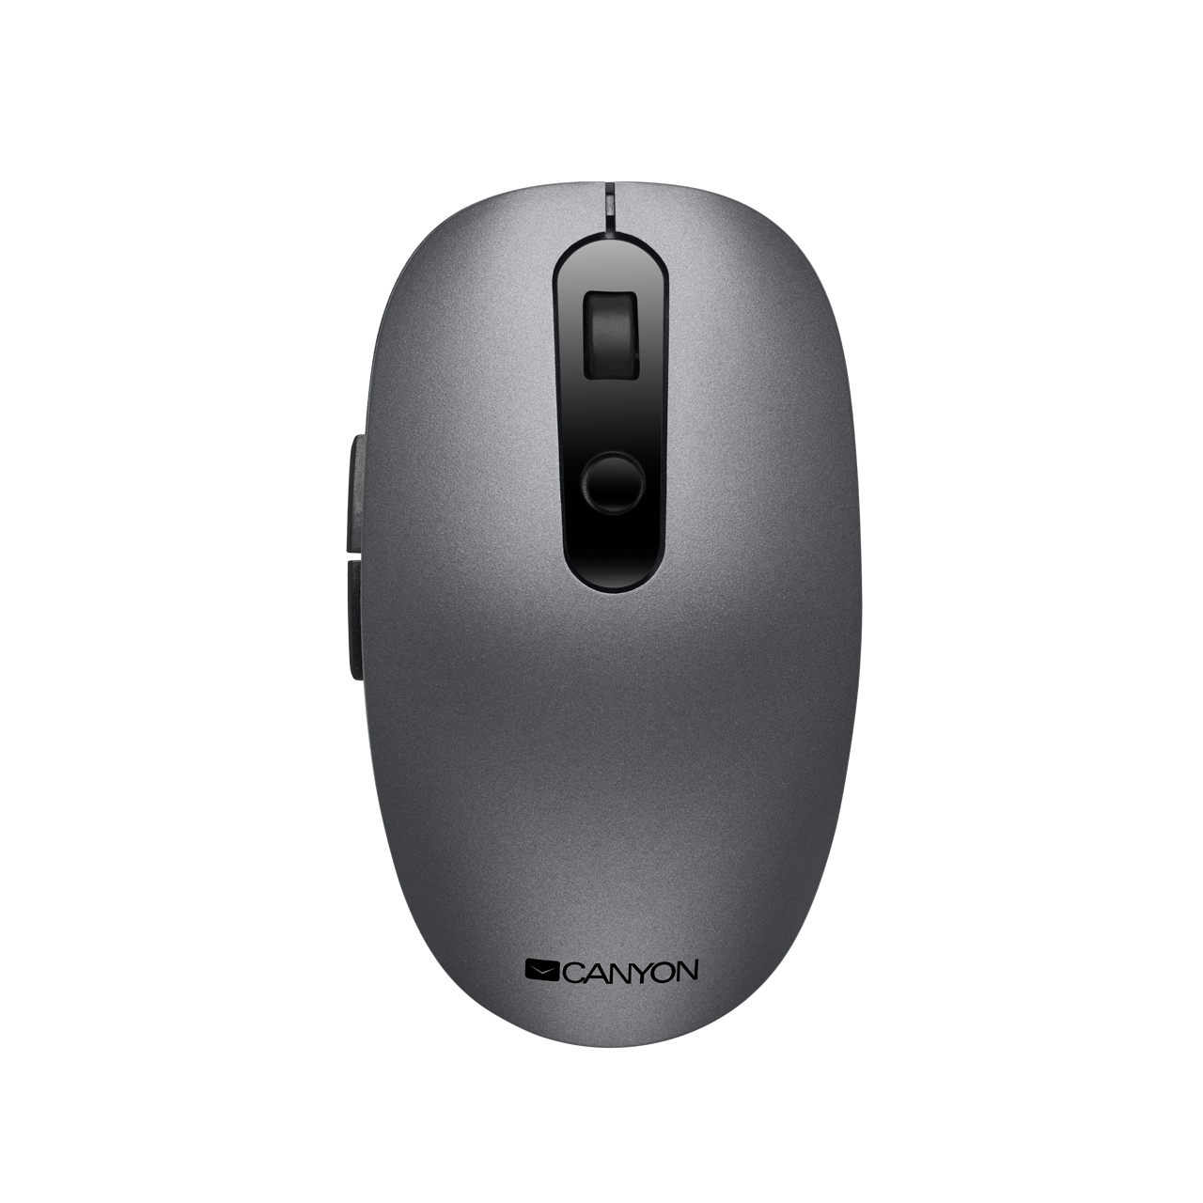
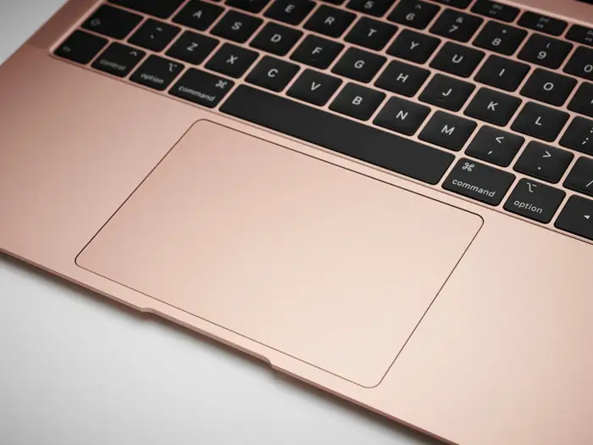
Mouse and Trackpad
Mouse
Trackpad
Both the mouse and trackpad are used to move the pointer on the screen, right and left click, and scroll

Slide 8
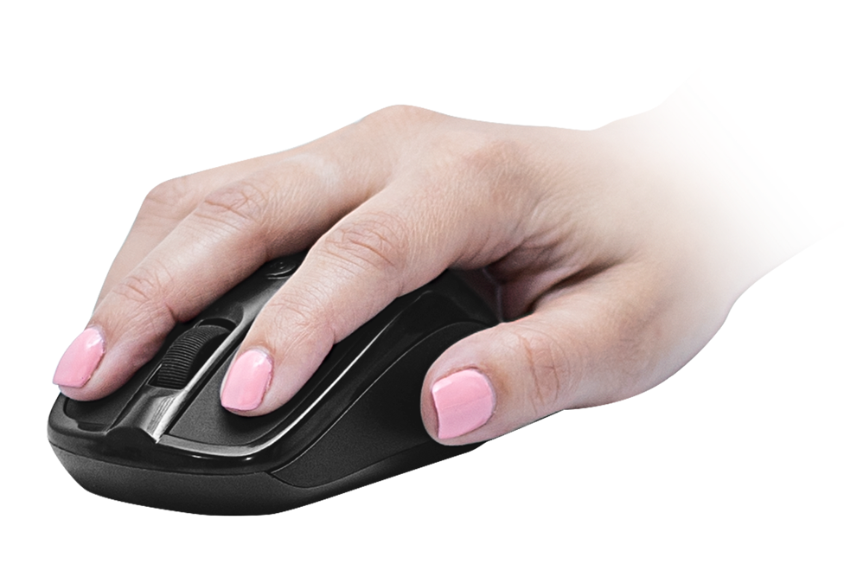
How to Use a Mouse
Left Click
Right Click
Scroll
Pointer
To move the pointer on the screen, simply move the entire mouse around

Slide 9
How to Use a Trackpad
Left Click
Right Click
To left click, press on the trackpad
To right click, press on the trackpad while holding down on the control button
Scroll
Pointer
To scroll, slide two fingers up or down the trackpad
To move the pointer on the screen, drag your finger along the trackpad

Slide 10
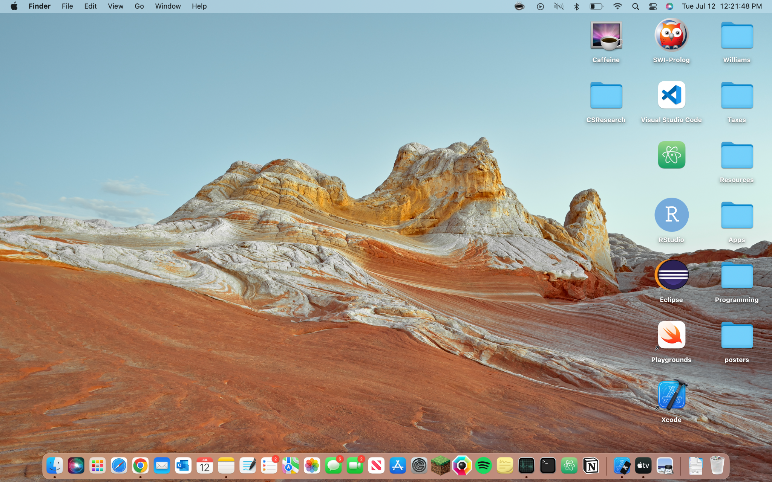
Desktop
The main screen on your computer is there desktop
There may be applications on your desktop
Or there may be applications in your navigation bar
Use your mouse or trackpad to click on and open an application

Slide 11
What’s Next?
You should now have the tools you need to begin using a computer!

